Slide 1


Slide 2
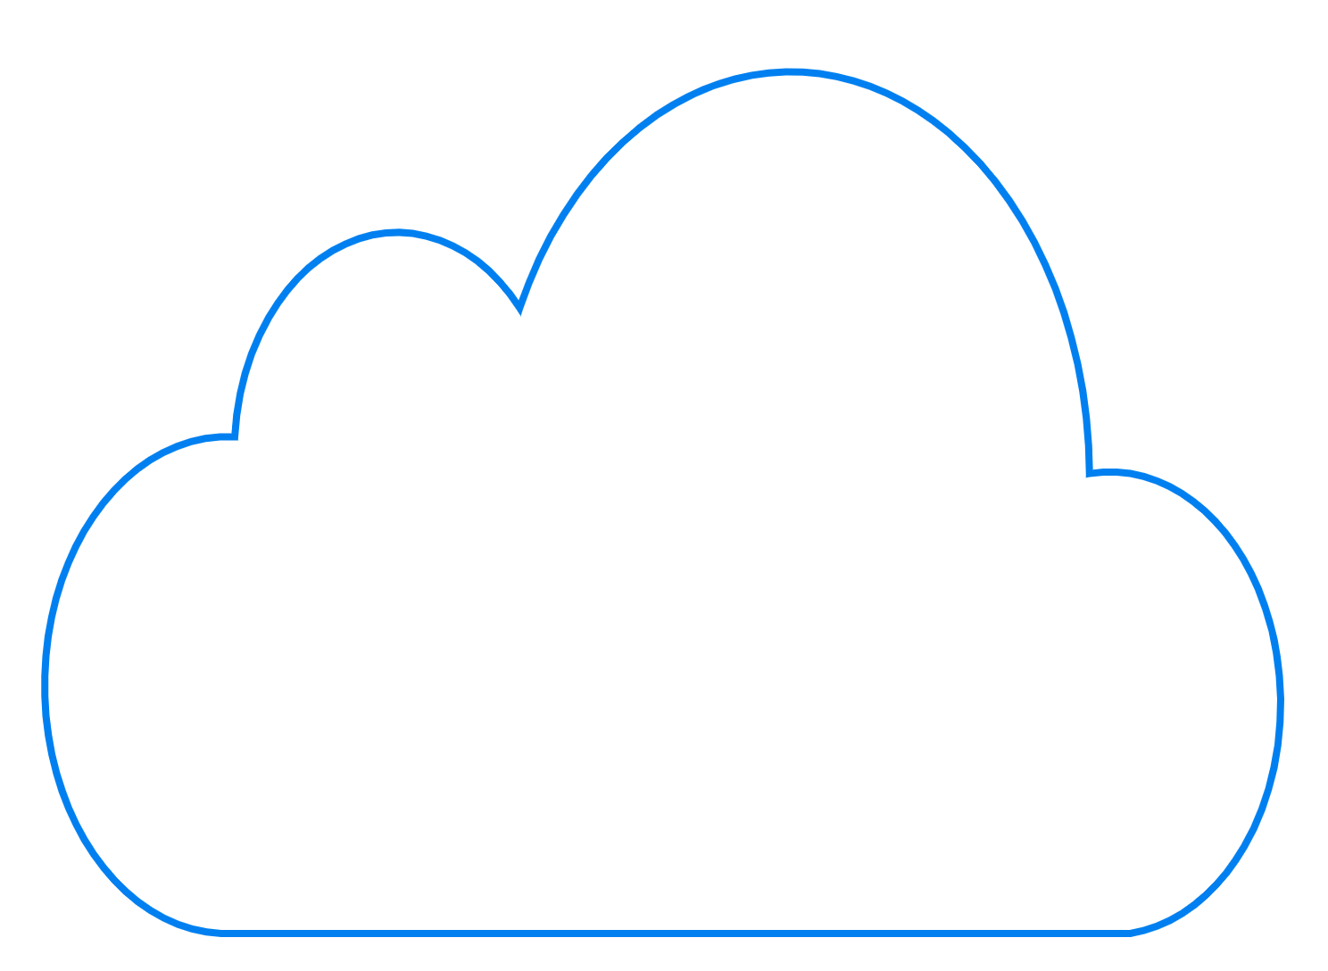

THE REASON FOR THE Cloud Engineering Practice and Management information systems
Durham Engineers Club – February 20, 2024
Brian Ceccarelli, PE
Talus Software, PLLC

Slide 3
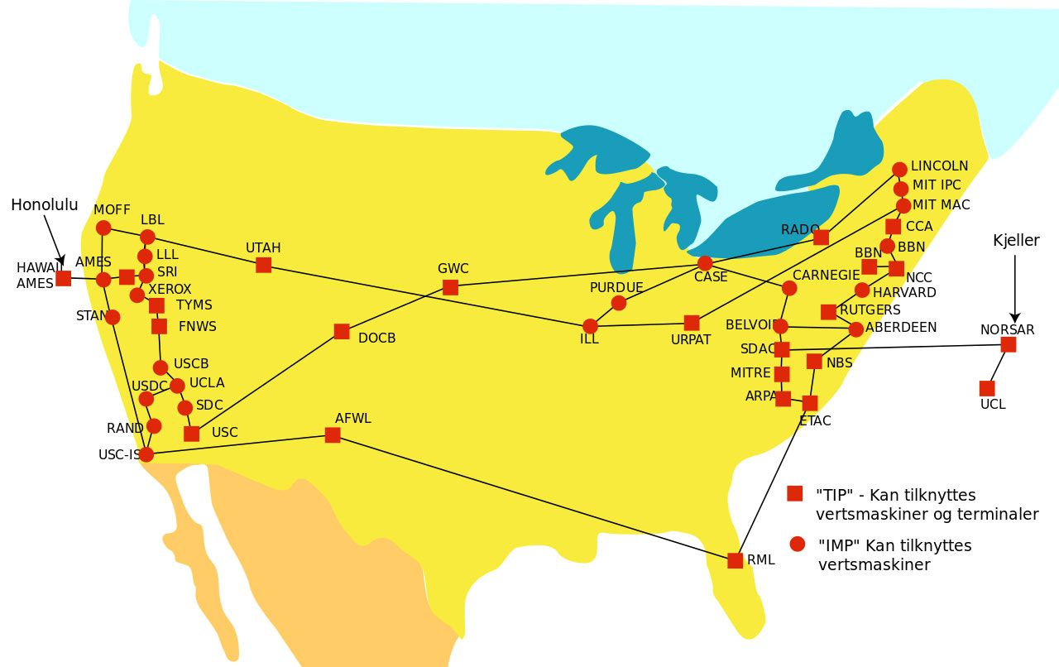
ARPANET - 1974

Slide 4
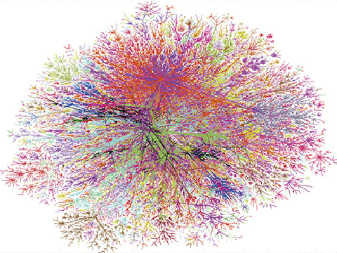
Internet - 1998

Slide 5
EASIER TO DRaw . . .

Slide 6
DEFINITION
A global network of remote servers designed to store and process data for other devices and computers.

Slide 7
Amazon Web Services
Google Cloud Platform
Microsoft Azure
. . .
IBM Cloud
Oracle Cloud
Alibaba
OpenShift

Slide 8


Slide 9
CONCEPT OF OPERATIONS
Brew Beer Manually and Devise Brewing Recipe
Observe and record temperatures, pressure, specific gravity, spectrograms v time. Send measurements to cloud database.
Automate Brewing using AI
Given previous measurements for a tasty brew, recreate the brew by downloading instructions to control fermenter.
Share Recipes
Use Amazon to ingest point-in-time spectrograms and use AWS SageMaker to decide how to adjust temperature throughout time to so that brew ends with target spectrogram.
Download and run commands from Cloud to fermenter. The process takes weeks.
Other breweries can download and upload recipes.

Slide 10
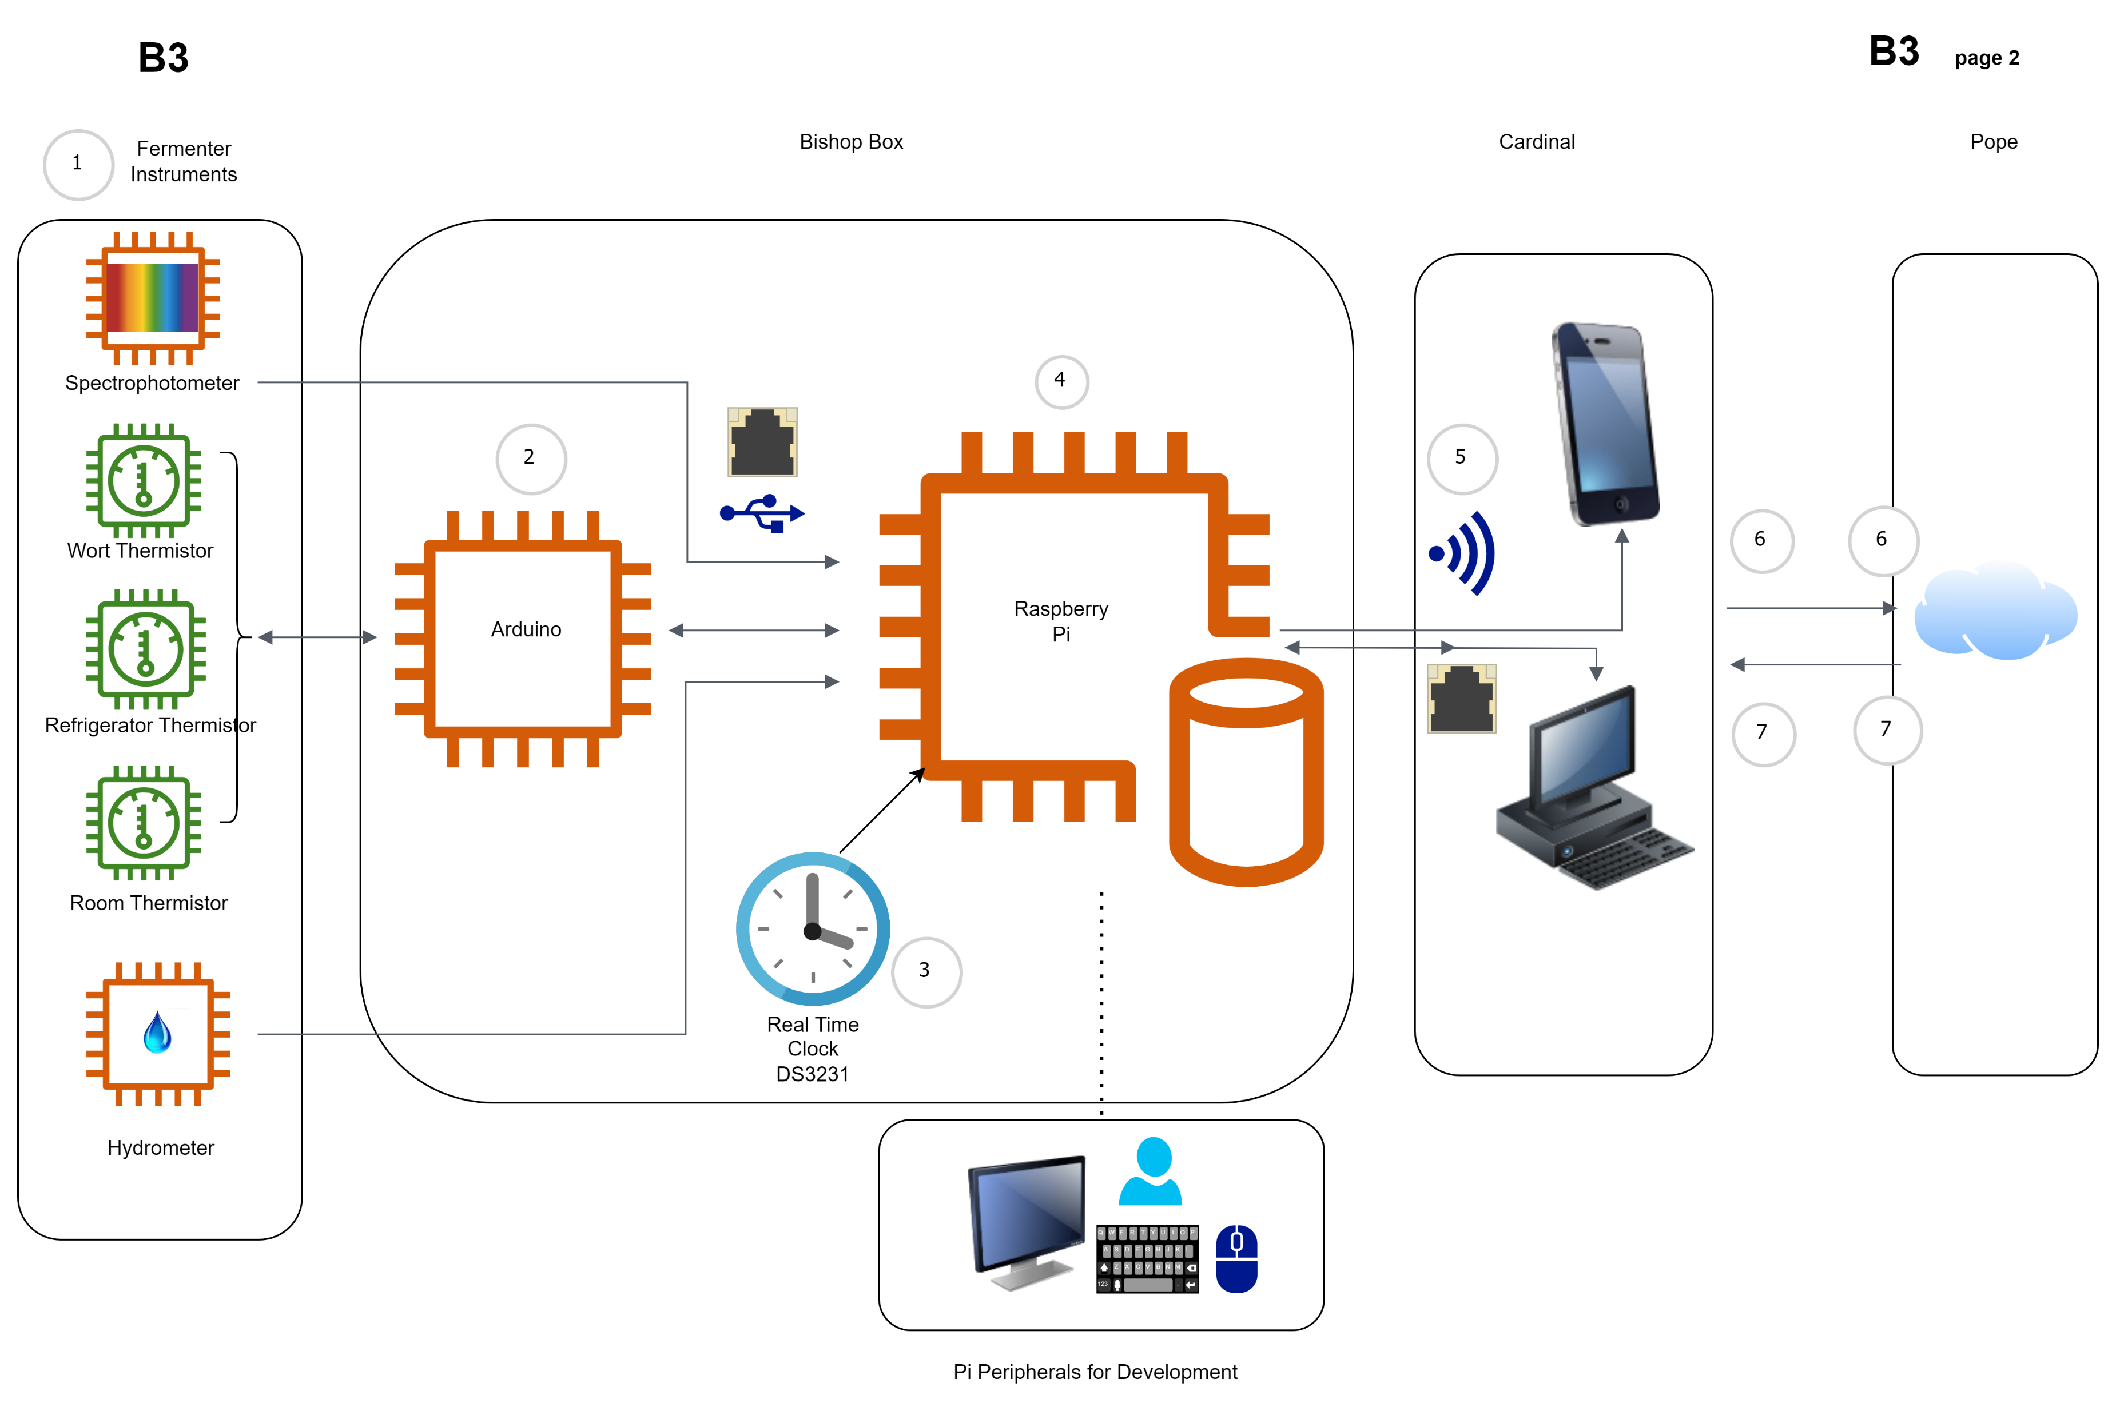

Slide 11
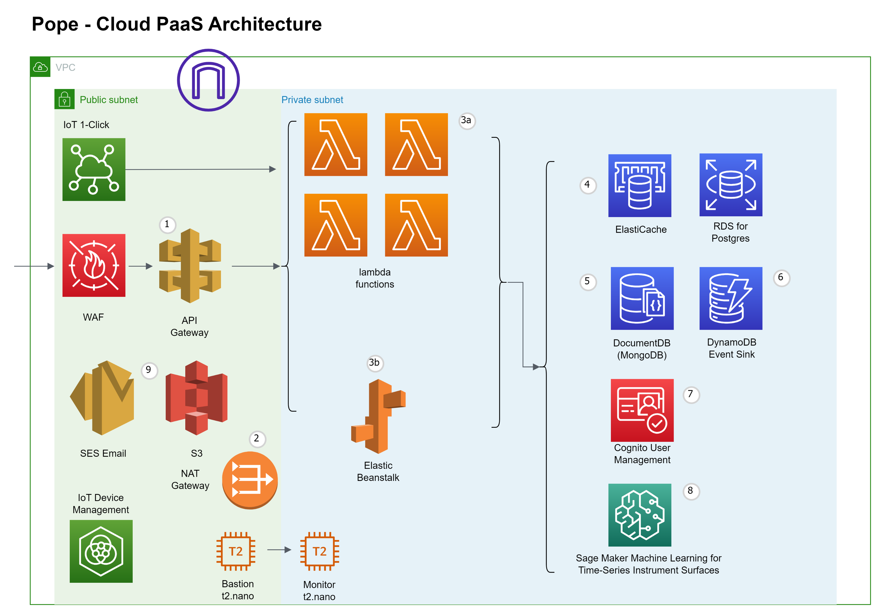

Slide 12
Paradigm Shifts
(Evolutionary Leaps)
Hardware
Architecture
Programming

Slide 13
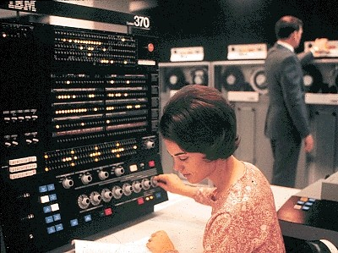
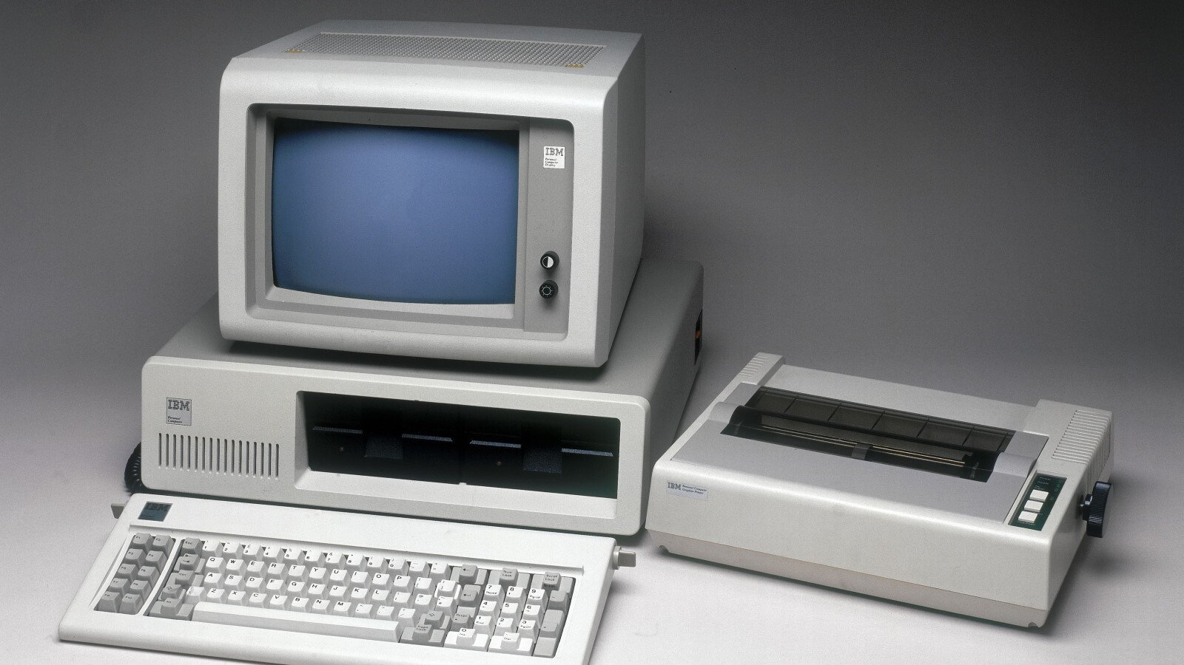
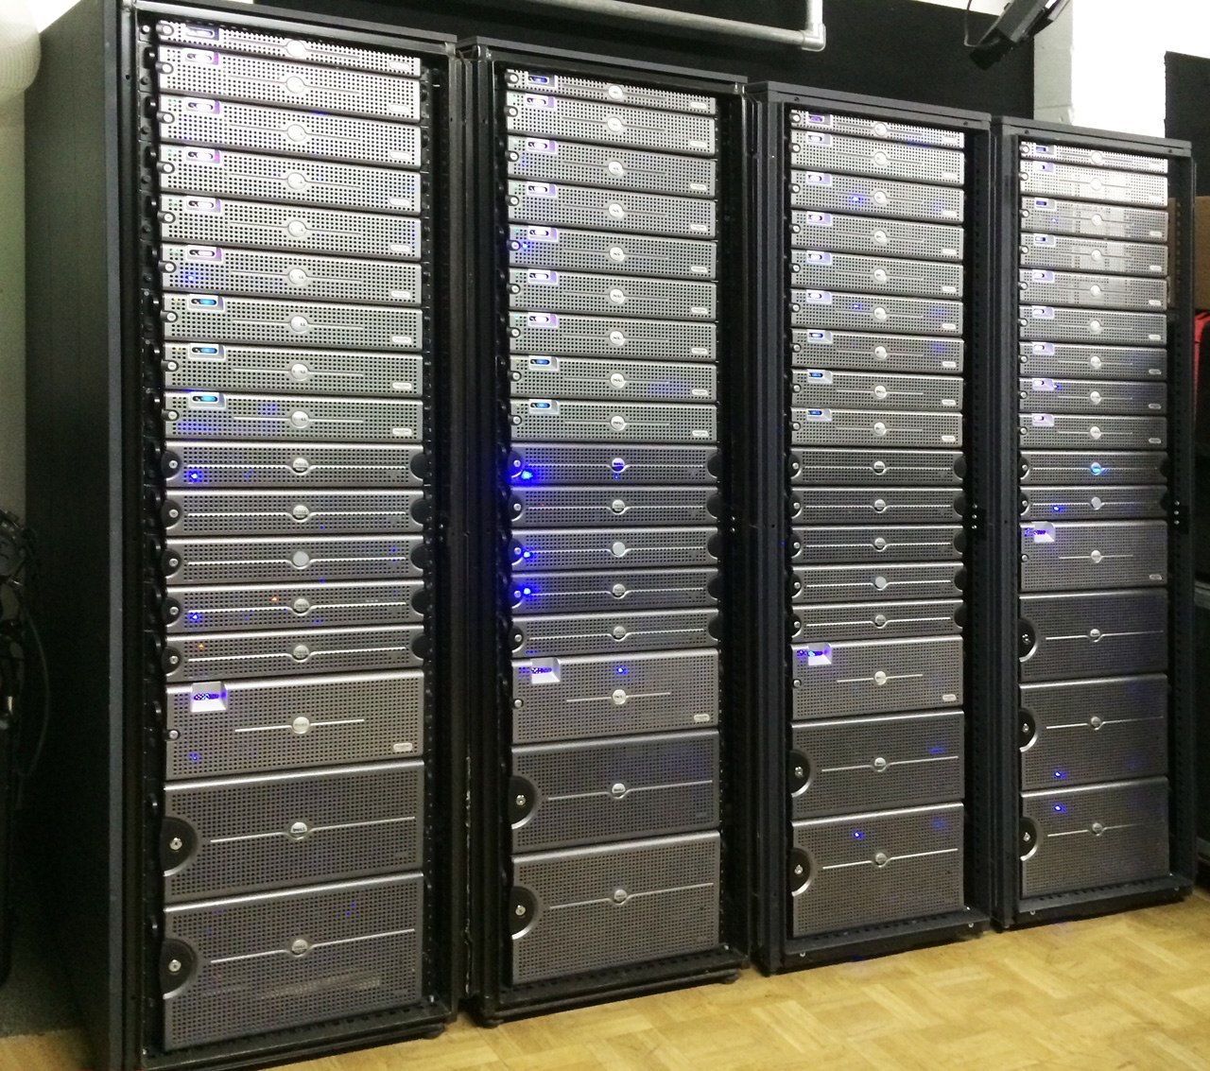
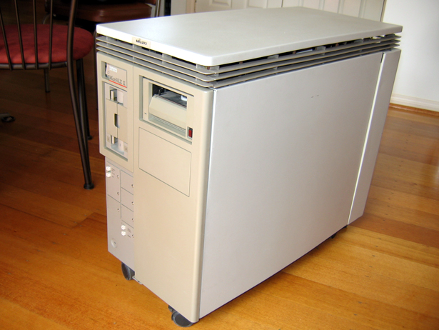
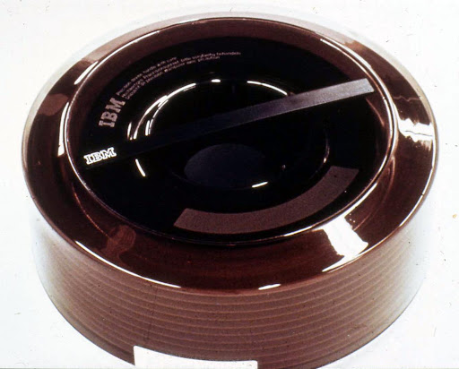
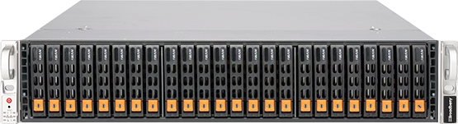
1970
1986
Today

Slide 14
ARCHITECTURE
Mainframe Batch
Mainframe Terminal
Client-Server
Service-Oriented
Cloud Microservices
1990
1980
1950
2000
2015
PROGRAMMING
Go-To
Structured Programming
Object-Oriented
1994
1978
1950
Aspect-Oriented
2012

Slide 15
What DOES this lecture have to do with Engineering?

Slide 16
Software Engineering
Management Information Services
Computer Science

Slide 17
Applications of Science and Mathematics
Architecture
Requirements: Functional, Non-Functional, Legal, Domain – Agile: Epochs and Stories
MTBF
Testing
Verification and Validation
Coverage
Processes
Science & Math: Avionics, Robotics, Atomics, Space Exploration
Redundancy
Availability – Control Theory
Software Engineering

Slide 18
Computer Science
Algorithms
Computer Vision
Machine Learning
Neural Networks
Area in a Polygon
Calculus
Conjunctive Normal Form
Shortest Distance Walk

Slide 19
Management Information Systems
Data Processing
(“Data Engineering”)
Cloud Computing
Accounting
Applications Architecture

Slide 20
Software Engineering
Management Information Services
Computer Science

Slide 21
ELEMents of a CLOUD

Slide 22
Services
IaaS
PaaS
SaaS
Infrastructure as a Service
Just the computers and network pieces. This replaces the “data center”.
Many companies do a “lift and shift”. Why?
Platform as a Service
The “platform” is what makes a cloud a cloud.
Access to your website from many “cloud-front” locations.
Redundant Disks, CPUs
Load Balancers
High Availability and Scalability
Software as a Service
There are companies like SalesForce, that write cloud-native CRM software. Firms like yours purchase a customized CRM solution.

Slide 23
DeV-OPS
DEV-Sec-Fin-Ops
Development
Security
Finances
Developers. Developers are the equivalent of construction workers.
In the past, developers were called programmers.
Programmers who also architected systems were called “Programmer/Analysts”.
VPC (Virtual Private Cloud)
Subnets
Organizations
Groups
Users
IAM (Identity and Access Management)
Timesharing has Returned
Expensive
Charged for I/Os
Charged for CPU
Charged for # Processors
Charged for Shared
Charged for Breathing

Slide 24


Traditional development and operations is like a wiener balloon.
A Cloud greatly expands the operations part.

Slide 25
THE Reason for A CLOUD

Slide 26
Customer-Centric
24/7 uptime
In the past, maintenance-centric was the goal. One would design systems to keep maintenance easy; that is, to minimize maintenance time. It was a given to have to take down a system for an hour on a Sunday night. Today, that is not OK

Slide 27



How does
&
keep customers happy?

Slide 28
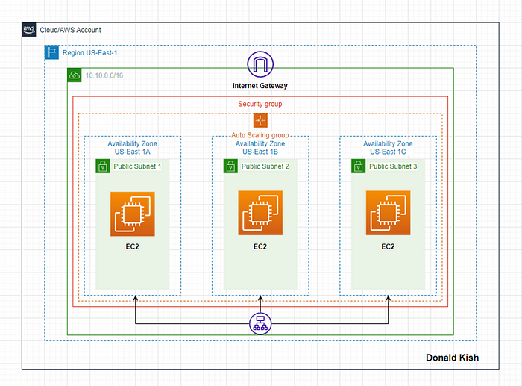
Regions
Availability Zones
Load Balancers

Slide 29
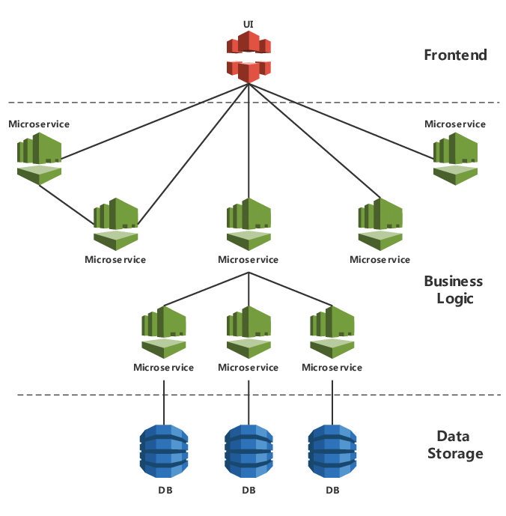
Microservice Architecture

Slide 30
Cloud –A Symbiosis of Engineering Practice and Management information systems
Durham Engineers Club – February 20, 2024
Brian Ceccarelli, PE
Talus Software, PLLC

